Slide 1
Corticosteroids
Dr.S.A.F.Kurukulasuriya

Slide 2
Contents
History
Introduction
Biosynthesis
Mechanism of action of steroids
Classes of steroids
Types of steroid

Slide 3
Contents contd…
Actions of steroids
Pharmacokinetics of steroids
Indications for steroids
Side effects of steroids
Precautions / Contraindications
Acute adrenocortical insufficiency

Slide 4
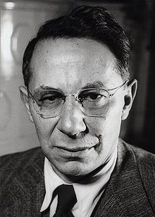
History
Tadeusz Reichestein and colleagues were awarded the Nobel Prize for in 1950 for their work on the hormones of the adrenal cortex.
Cortisone was isolated by them.

Slide 5
Introduction
A class of steroid hormones produced in the adrenal cortex.
Structurally and Pharmacologically similar to endogenous cortisol
Involved in the
Stress response
Immune response
Regulation of inflammation
Carbohydrate and protein metabolism
Blood electrolyte levels
Behaviour

Slide 6
Cholesterol
Pregnenolone
Progesterone
11-deoxycorticosterone
Corticosterone
18-hydroxy-corticosterone
Aldosterone
Corticosterone

Slide 7
Mechanism of action of steroids
Not water soulble.
Travels bound to protein carriers.
Target cell-Dissociates from carrier. Moves through plasma membrane.
Forms hormone –receptor complex in cytoplasm
Nucleus-binds DNA
Effects transcription (m RNA) →specific proteins

Slide 8
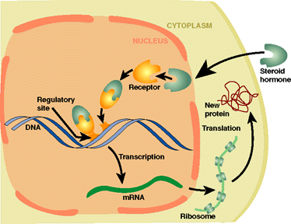

Slide 9
Metabolism of steroids
By cytochrome P450 oxidase
Bile acids are the final product

Slide 10
Classes of corticosteroids
4 classes based on chemical structure
Group A-Hydrocortisone,Hydrocortisone acetate
Group B-Triamcenelone acetonide, Budesonide
Group C-Betamethasone,Dexamethasone
Group D-Hydrocortisone 17-butyrate, Betamethasone

Slide 11
Types of corticosteroids
Skin, eye, mucous membranes
Nasal mucosa,sinuses,bronci,lungs
Oral (prednisone, prednisolone)
intravenously

Slide 12
Actions of hydrocortisone
Mineralocorticoid effects
Glucocorticoid effects

Slide 13
Mineralocorticoid effects
Increased retention of sodium by the renal tubule
Increased excretion of potassium in the urine
(modulating ion transport in the epithelial cells of the renal tubules of the kidney)

Slide 14
Glucocorticoid effects
Carbohydrate metabolism-Increased gluconeogenisis,Hyperglycaemia, Glycosuria
Protein metabolism-negative nitrogen balance with muscle wasting,
Osteoporosis, delayed wound healing.
Fat deposition increased

Slide 15
Glucocorticoid effects contd…
Inflammatory response depressed-Neutrophil and macrophage function depressed
Immunosuppressive- delayed hypersensitivity reactions
Allergic response suppressed
Anti vitamin D action
Reduction of hypercalcaemia (Sarcoidosis, Hyperparathyroidism)

Slide 16
Glucocorticoid effects contd…
Urinary calcium excretion increased
Anti proliferative effects-inhibition of DNA synthesis and cell turnover
Vasoconstrictive effects

Slide 17
Hydrocortisone
The principal naturally occurring steroid
Oral /I.V. /intra-articularly
The I.V. form is given for rapid effect in emergency (deficiency,allergy or inflammatory disease)

Slide 18
Prednisolone
Biologically active
Mainly anti-inflammatory(glucocorticoid)
Little sodium retaining activity

Slide 19
Triamcinolone
Fluorinated corticosteroid
No mineralocorticoid activity
May cause muscle wasting, anorexia, depression

Slide 20
Fludrocortisone
Great sodium retaining effect
Little anti-inflammatory action
To replace aldosterone where the adrenal cortex is destroyed(Addison’s disease)
Used in autonomic neuropathy-for volume expansion (MSA)

Slide 21
Beclomethasone and budesonide
For bronchial asthma-inhalation route
Most of the inhaled dose is swallowed.
Can give a very low systemic plasma concentration.

Slide 22
Pharmacokinetics of steroids
Topical steroids (skin,lungs,joints) can cause enough absorption to cause systemic side effects.
In the blood 5% of the steroids are carried free(active form).The rest is bound to transcortin.
Hence steroid dose should be reduced in low albumin states and liver disease.

Slide 23
Indications for use of steroids
Acute severe asthma
Exfoliative dermatitis and pemphigus
SLE,Polymyalgia rheumatica,giant cell arteritis,dermatomyositis
Acquired haemolytic anaemia
Severe allergic reactions
Organ transplant rejection

Slide 24
Indications contd..
Rheumatoid arthritis
Ulcerative colitis and proctitis
Crohn’s disease
Nephrotic syndrome

Slide 25
Reducing hypothalamo/pituitary/adrenal suppression
Single daily dose –early morning
Alternative day schedules
Short courses
Mega doses far apart

Slide 26
Side effects of steroid treatment
Usually follow prolonged administration
Cushing’s syndrome
Diabetes mellitus
Proximal myopathy
Osteoporosis
Avascular necrosis of bone
Spread of infection and atypical features

Slide 27
Side effects of steroids contd…
Peptic ulcer and haemorrhage
Pancreatitis
Depression,psychosis,insomnia
Posterior subcapsular lens cataract, glaucoma
Growth retardation in children-esp. if treatment exceeds 6 months.

Slide 28
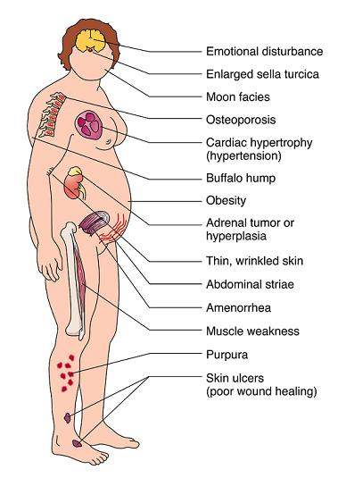

Slide 29
Precautions / chronic steroid therapy
Use the minimum dose to get the desired effect
Patient education
Carry a card containing details of therapy
What to do if they intercurrent illness or other severe stress-double the dose & tell the doctor
What to do if they miss a dose- take the dose as soon as possible
Vomiting-may require parentral administration

Slide 30
Precautions contd…
Major operations-hydrocortisone 100-200 mg i.m./ i.v.with premedication and repeated 6 hrly for 24-72 hrs.
Minor operations-hydrocortisone 20 mg by mouth before and after surgery.

Slide 31
Cautions
Used only for serious reasons in patients with
Diabetes
Mental disorder
Peptic ulcer disease
Tuberculosis
Epilepsy
Hypertention/heart failure

Slide 32
Contraindications
Topical corticosteroids in eye inflammation due to herpes virus
Florinated steroids in diabetes

Slide 33
Acute adrenocortical insufficiency
Also known as addisonian crisis
A MEDICAL EMERGENCY
100 mg of hydrocortisone on suspicion
Infusion of 0.9% NaCl & second 100 mg of hydrocortisone added to first litre.
Hydrocortisone 50-100 mg given every 6 hrs
Initiate oral dose of steroids
Treat cause

Slide 34
QUIZ
Mode of action of steroid hormones include
a) 2nd messenger
b) Modification of enzyme activity
c) Stimulation of DNA replication
d) Stimulation of RNA transcription
e) Inhibition of protein synthesis

Slide 35
Answer- D

Slide 36
Steroid hormones travel in blood attached to protein carriers
a) True
b) False

Slide 37
Answer -a

Slide 38
Steroid hormones are water soluble
a) True
b) False

Slide 39
Answer- b

